Slide 1

Week # 8
Operations Research
(Software Engineering)

Slide 2
Big m method
Big-M method is a modified form of two phase method. Here M is a very large positive value.
As M-technique is modified form of “Two phase”. In Two phase method we use a new function along with the original objective function. But in M technique we use the main objective function and multiply artificial function with ‘M’ and subtract it for maximization case and for minimization case we add it.

Slide 3

Big m method
Example 1:
$$Max Z=3x_{1}+{2x}_{2}$$
Subject to Constraints:
$${2x}_{1}+x_{2}≤9$$
$$x_{1}+{2x}_{2}≥9$$

Slide 4
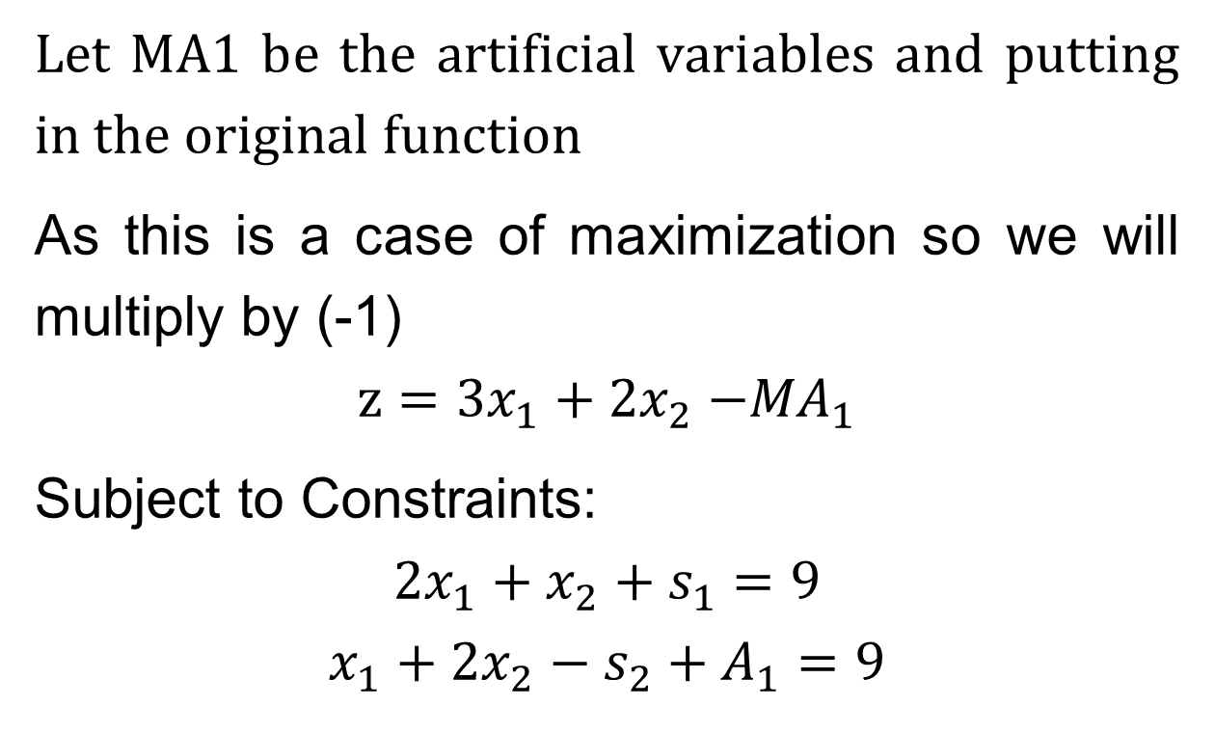
Big m method
Let MA1 be the artificial variables and putting in the original function
As this is a case of maximization so we will multiply by (-1)
$$z=3x_{1}+{2x}_{2}{−MA}_{1}$$
Subject to Constraints:
$${2x}_{1}+x_{2}+s_{1}=9$$
$$x_{1}+2x_{2}−s_{2}+A_{1}=9$$

Slide 5
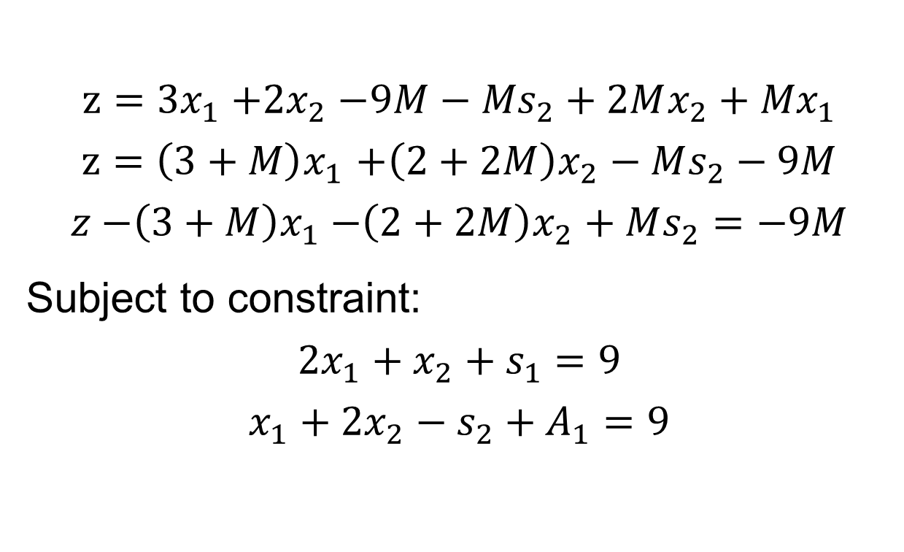
Big m method
$$z={3x}_{1}{+2x}_{2}{−9M−Ms}_{2}+2Mx_{2}+{Mx}_{1}$$
$$z{=\left(3+M\right)x}_{1}+\left(2+2M\right)x_{2}−Ms_{2}−9M$$
$$z{−\left(3+M\right)x}_{1}−\left(2+2M\right)x_{2}+Ms_{2}=−9M$$
Subject to constraint:
$${2x}_{1}+x_{2}+s_{1}=9$$
$$x_{1}+2x_{2}−s_{2}+A_{1}=9$$

Slide 6
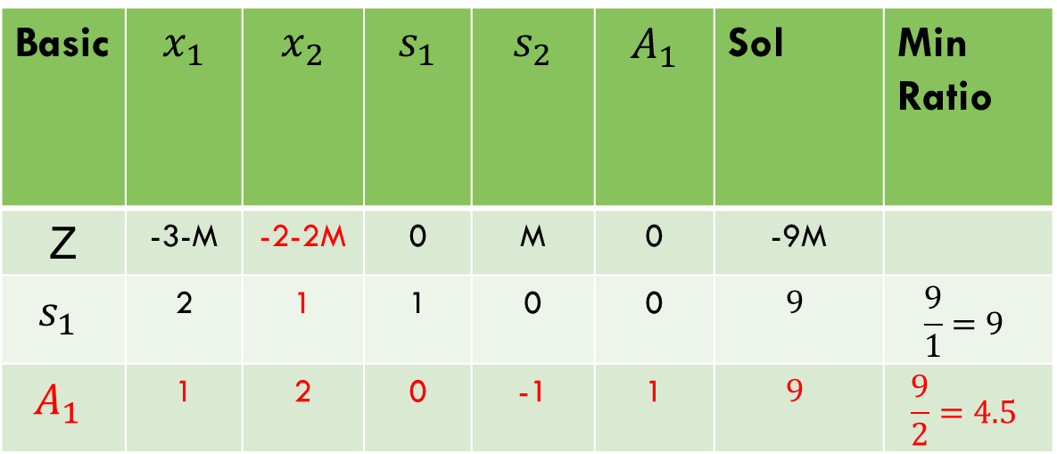
Big m method
Basic | $$x_{1}$$ | $$x_{2}$$ | $$s_{1}$$ | $$s_{2}$$ | $$A_{1}$$ | Sol | Min Ratio
Z | -3-M | -2-2M | 0 | M | 0 | -9M
$$s_{1}$$ | 2 | 1 | 1 | 0 | 0 | $$9$$ | $$\frac{9}{1}=9$$
$$A_{1}$$ | 1 | 2 | 0 | -1 | 1 | $$9$$ | $$\frac{9}{2}=4.5$$

Slide 7
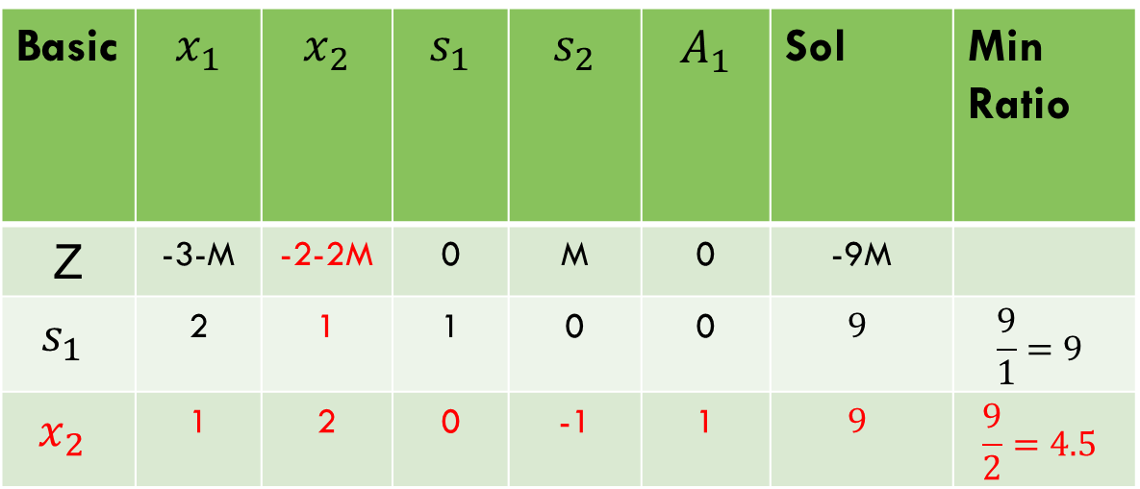
Big m method
Basic | $$x_{1}$$ | $$x_{2}$$ | $$s_{1}$$ | $$s_{2}$$ | $$A_{1}$$ | Sol | Min Ratio
Z | -3-M | -2-2M | 0 | M | 0 | -9M
$$s_{1}$$ | 2 | 1 | 1 | 0 | 0 | $$9$$ | $$\frac{9}{1}=9$$
$$x_{2}$$ | 1 | 2 | 0 | -1 | 1 | $$9$$ | $$\frac{9}{2}=4.5$$

Slide 8
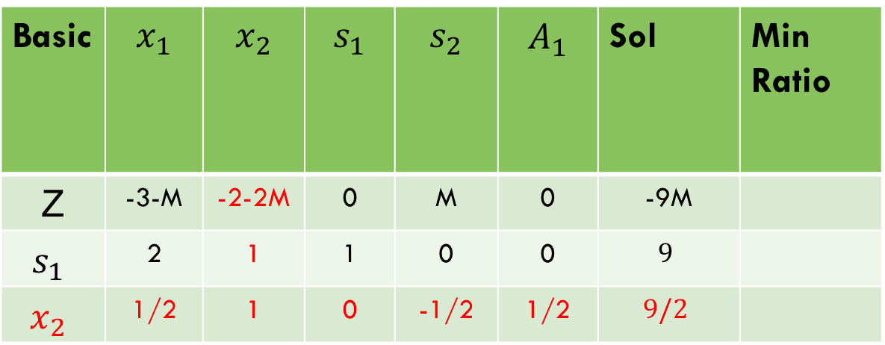
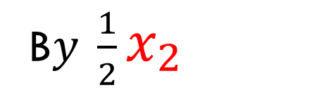
Big m method
Basic | $$x_{1}$$ | $$x_{2}$$ | $$s_{1}$$ | $$s_{2}$$ | $$A_{1}$$ | Sol | Min Ratio
Z | -3-M | -2-2M | 0 | M | 0 | -9M
$$s_{1}$$ | 2 | 1 | 1 | 0 | 0 | $$9$$
$$x_{2}$$ | 1/2 | 1 | 0 | -1/2 | 1/2 | $$9/2$$
B$y \frac{1}{2}x_{2}$

Slide 9

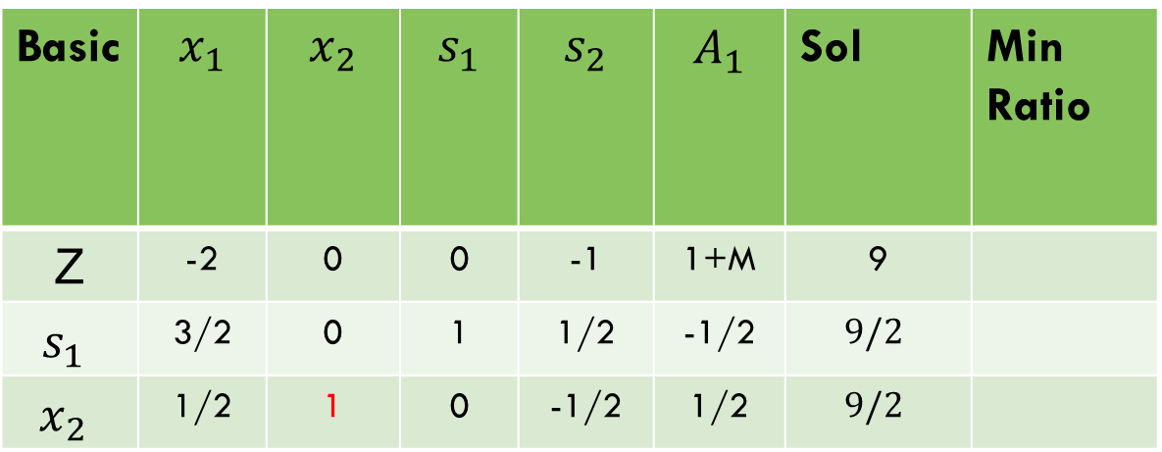

Big m method
Basic | $$x_{1}$$ | $$x_{2}$$ | $$s_{1}$$ | $$s_{2}$$ | $$A_{1}$$ | Sol | Min Ratio
Z | -2 | 0 | 0 | -1 | 1+M | 9
$$s_{1}$$ | 3/2 | 0 | 1 | 1/2 | -1/2 | $$9/2$$
$$x_{2}$$ | 1/2 | 1 | 0 | -1/2 | 1/2 | $$9/2$$
$s_{1}−x_{2}$,
z$+(2+2M)x_{2}$,

Slide 10
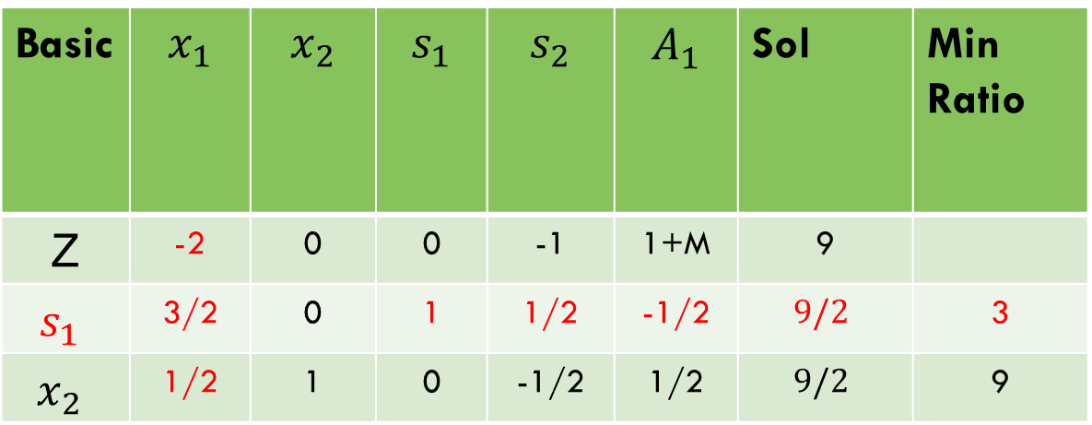
Big m method
Basic | $$x_{1}$$ | $$x_{2}$$ | $$s_{1}$$ | $$s_{2}$$ | $$A_{1}$$ | Sol | Min Ratio
Z | -2 | 0 | 0 | -1 | 1+M | 9
$$s_{1}$$ | 3/2 | 0 | 1 | 1/2 | -1/2 | $$9/2$$ | 3
$$x_{2}$$ | 1/2 | 1 | 0 | -1/2 | 1/2 | $$9/2$$ | 9

Slide 11
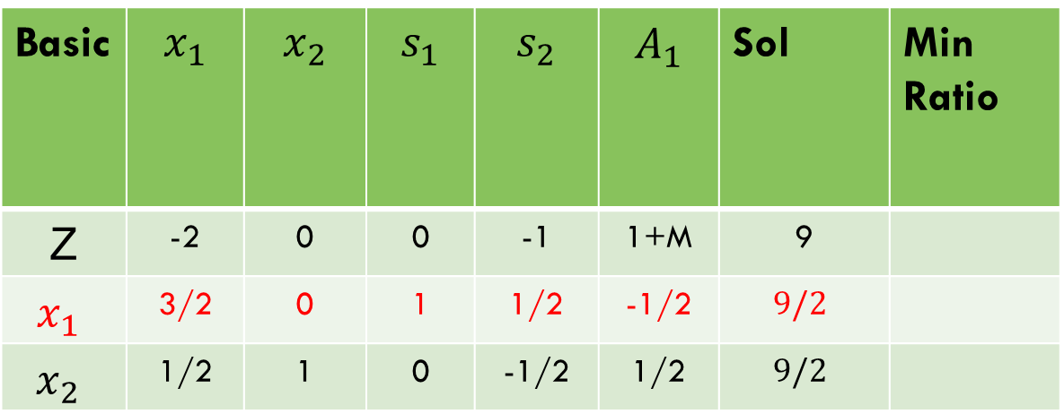
Big m method
Basic | $$x_{1}$$ | $$x_{2}$$ | $$s_{1}$$ | $$s_{2}$$ | $$A_{1}$$ | Sol | Min Ratio
Z | -2 | 0 | 0 | -1 | 1+M | 9
$$x_{1}$$ | 3/2 | 0 | 1 | 1/2 | -1/2 | $$9/2$$
$$x_{2}$$ | 1/2 | 1 | 0 | -1/2 | 1/2 | $$9/2$$

Slide 12
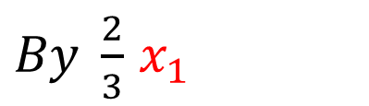
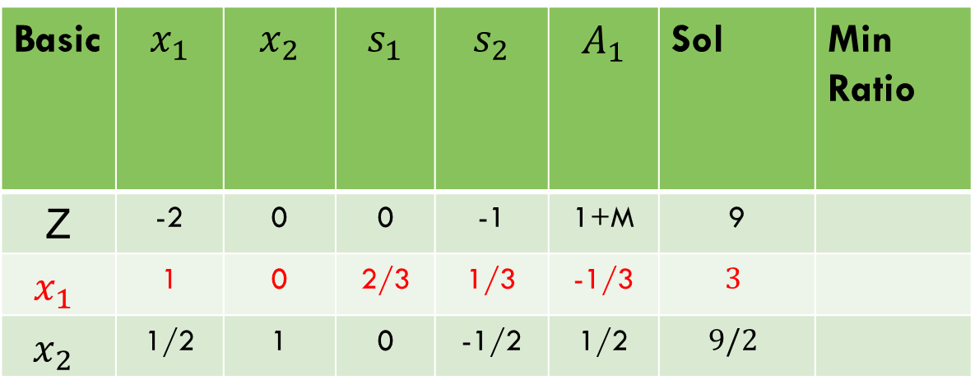
Big m method
Basic | $$x_{1}$$ | $$x_{2}$$ | $$s_{1}$$ | $$s_{2}$$ | $$A_{1}$$ | Sol | Min Ratio
Z | -2 | 0 | 0 | -1 | 1+M | 9
$$x_{1}$$ | 1 | 0 | 2/3 | 1/3 | -1/3 | $$3$$
$$x_{2}$$ | 1/2 | 1 | 0 | -1/2 | 1/2 | $$9/2$$
$By \frac{2}{3}$ $x_{1}$

Slide 13


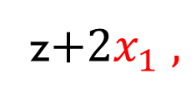
Big m method
Basic | $$x_{1}$$ | $$x_{2}$$ | $$s_{1}$$ | $$s_{2}$$ | $$A_{1}$$ | Sol | Min Ratio
Z | 0 | 0 | 4/3 | -1/3 | $\frac{1}{3}$+M | 15
$$x_{1}$$ | 1 | 0 | 2/3 | 1/3 | -1/3 | $$3$$
$$x_{2}$$ | 0 | 1 | -1/3 | -2/3 | 2/3 | $$3$$
$x_{2}−\frac{1}{2}$ $x_{1} ,$
z$+2x_{1} ,$

Slide 14
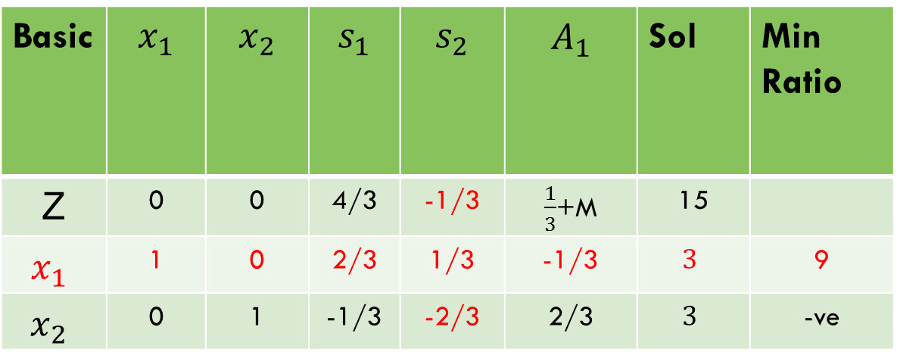
Big m method
Basic | $$x_{1}$$ | $$x_{2}$$ | $$s_{1}$$ | $$s_{2}$$ | $$A_{1}$$ | Sol | Min Ratio
Z | 0 | 0 | 4/3 | -1/3 | $\frac{1}{3}$+M | 15
$$x_{1}$$ | 1 | 0 | 2/3 | 1/3 | -1/3 | $$3$$ | 9
$$x_{2}$$ | 0 | 1 | -1/3 | -2/3 | 2/3 | $$3$$ | -ve

Slide 15

Big m method
Basic | $$x_{1}$$ | $$x_{2}$$ | $$s_{1}$$ | $$s_{2}$$ | $$A_{1}$$ | Sol | Min Ratio
Z | 0 | 0 | 4/3 | -1/3 | $\frac{1}{3}$+M | 15
$$s_{2}$$ | 1 | 0 | 2/3 | 1/3 | -1/3 | $$3$$ | 9
$$x_{2}$$ | 0 | 1 | -1/3 | -2/3 | 2/3 | $$3$$ | -ve

Slide 16
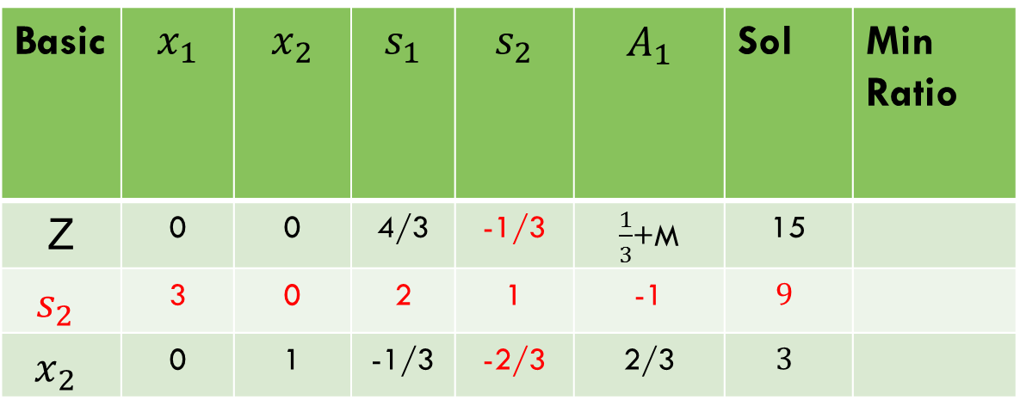
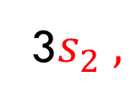
Big m method
Basic | $$x_{1}$$ | $$x_{2}$$ | $$s_{1}$$ | $$s_{2}$$ | $$A_{1}$$ | Sol | Min Ratio
Z | 0 | 0 | 4/3 | -1/3 | $\frac{1}{3}$+M | 15
$$s_{2}$$ | 3 | 0 | 2 | 1 | -1 | $$9$$
$$x_{2}$$ | 0 | 1 | -1/3 | -2/3 | 2/3 | $$3$$
3$s_{2} ,$

Slide 17
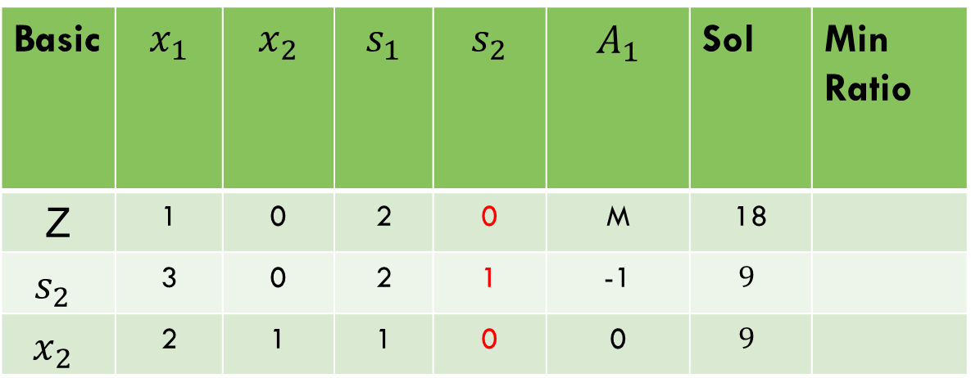

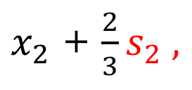
Big m method
Basic | $$x_{1}$$ | $$x_{2}$$ | $$s_{1}$$ | $$s_{2}$$ | $$A_{1}$$ | Sol | Min Ratio
Z | 1 | 0 | 2 | 0 | M | 18
$$s_{2}$$ | 3 | 0 | 2 | 1 | -1 | $$9$$
$$x_{2}$$ | 2 | 1 | 1 | 0 | 0 | $$9$$
Z - ${\frac{1}{3}s}_{2} ,$
$x_{2}$ + ${\frac{2}{3}s}_{2} ,$

Slide 18
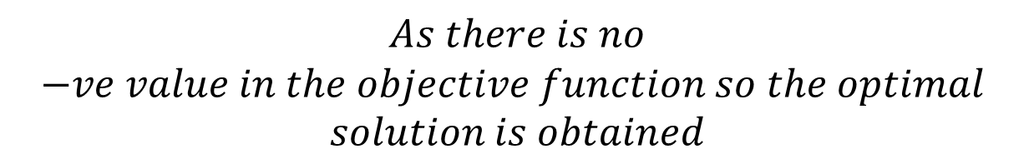
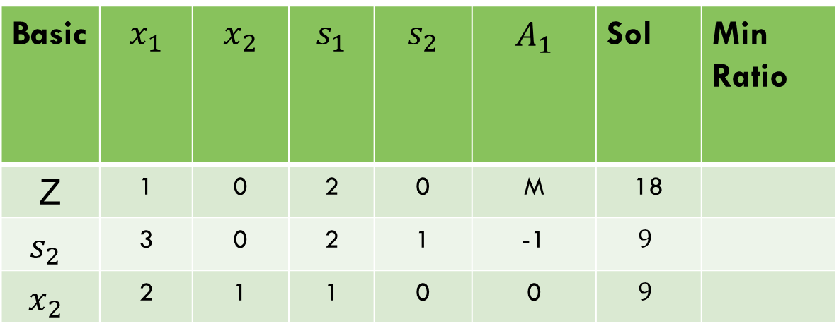
Big m method
Basic | $$x_{1}$$ | $$x_{2}$$ | $$s_{1}$$ | $$s_{2}$$ | $$A_{1}$$ | Sol | Min Ratio
Z | 1 | 0 | 2 | 0 | M | 18
$$s_{2}$$ | 3 | 0 | 2 | 1 | -1 | $$9$$
$$x_{2}$$ | 2 | 1 | 1 | 0 | 0 | $$9$$
$$As there is no$$
$$−ve value in the objective function so the optimal$$
$$solution is obtained$$

Slide 19

Big m method
Example 2:
$$Min Z=4x_{1}+x_{2}$$
Subject to Constraints:
$${3x}_{1}+x_{2}=3$$
$$4x_{1}+{3x}_{2}≥ 6$$
$$x_{1}+{2x}_{2}≤4$$

Slide 20
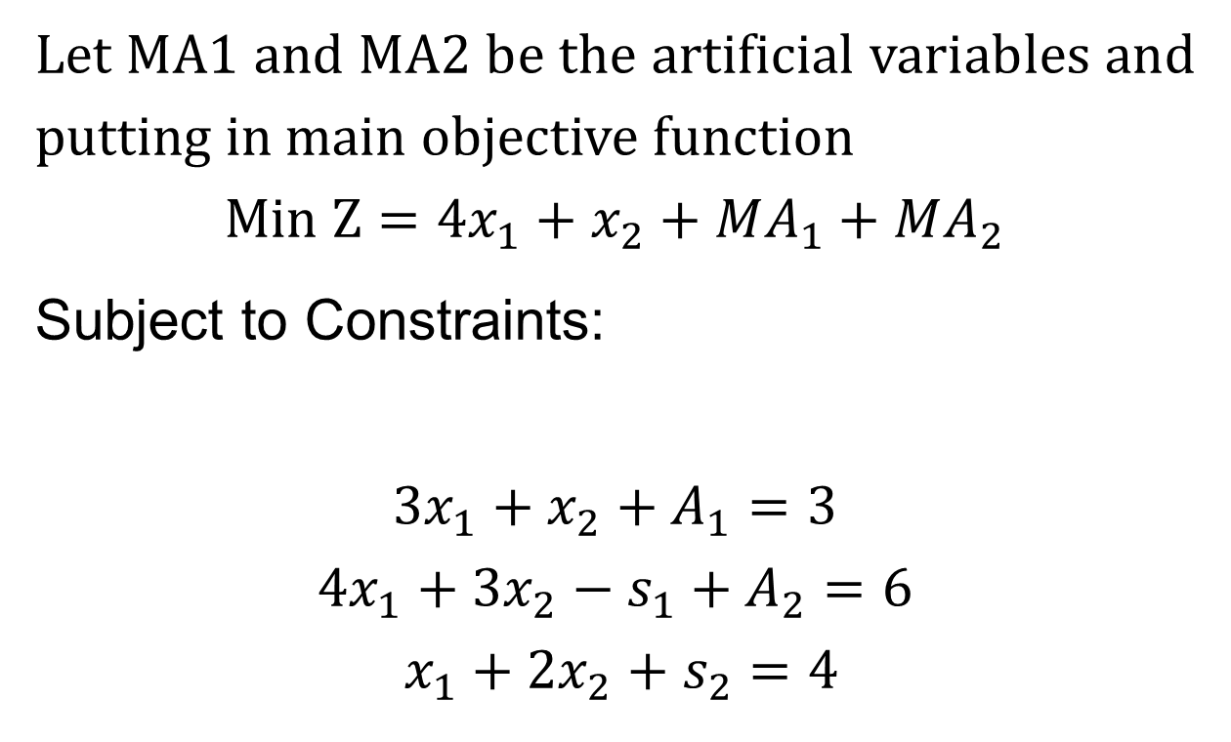
Big m method
Let MA1 and MA2 be the artificial variables and putting in main objective function
$$Min Z=4x_{1}+x_{2}+MA_{1}+MA_{2}$$
Subject to Constraints:
$${3x}_{1}+x_{2}+A_{1}=3$$
$$4x_{1}+{3x}_{2}−s_{1}+A_{2}=6$$
$$x_{1}+{2x}_{2}+s_{2}=4$$

Slide 21
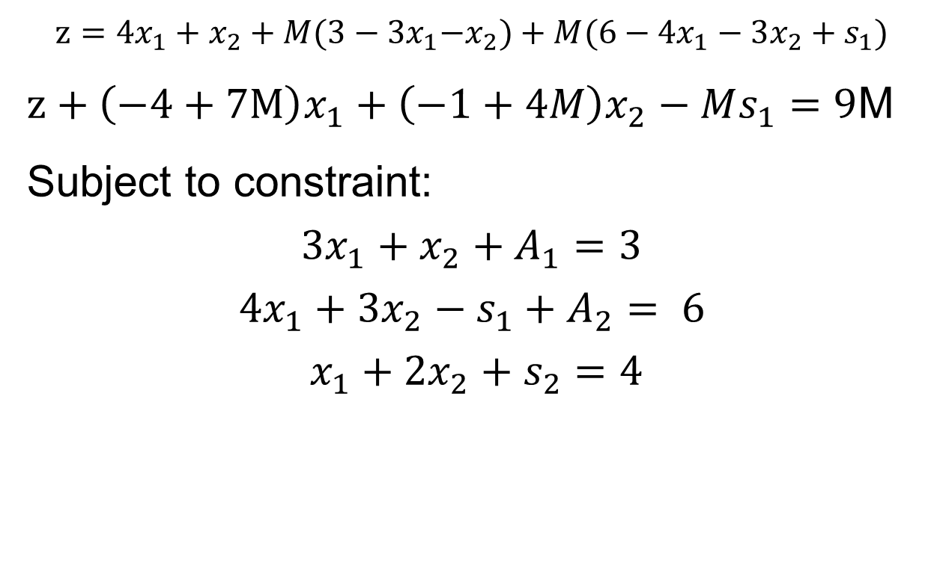
Big m method
$$z=4x_{1}+x_{2}+M{(3−3x}_{1}−x_{2})+{M(6−4x}_{1}−3x_{2}+s_{1})$$
$z+\left(−4+7M\right)x_{1}+\left(−1+4M\right)x_{2}−Ms_{1}=9$M
Subject to constraint:
$${3x}_{1}+x_{2}+A_{1}=3$$
$$4x_{1}+{3x}_{2}−s_{1}+A_{2}= 6$$
$$x_{1}+{2x}_{2}+s_{2}=4$$

Slide 22
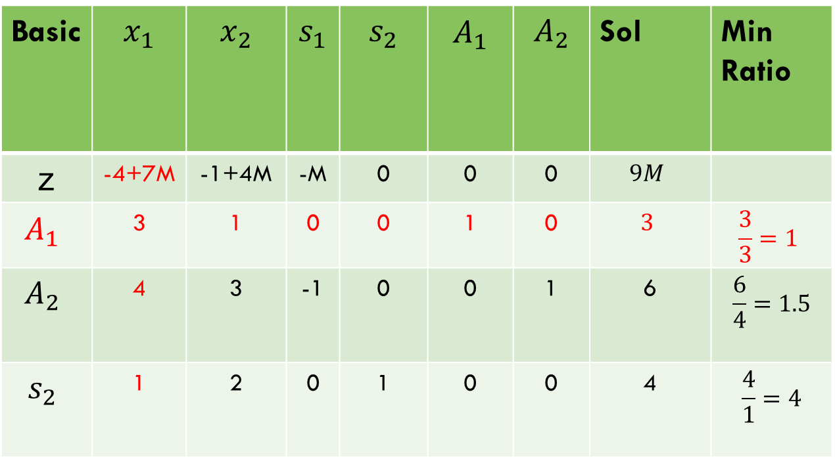
Big m method
Basic | $$x_{1}$$ | $$x_{2}$$ | $$s_{1}$$ | $$s_{2}$$ | $$A_{1}$$ | $$A_{2}$$ | Sol | Min Ratio
z | -4+7M | -1+4M | -M | 0 | 0 | 0 | $$9M$$
$$A_{1}$$ | 3 | 1 | 0 | 0 | 1 | 0 | $$3$$ | $$\frac{3}{3}=1$$
$$A_{2}$$ | 4 | 3 | -1 | 0 | 0 | 1 | 6 | $$\frac{6}{4}=1.5$$
$$s_{2}$$ | 1 | 2 | 0 | 1 | 0 | 0 | 4 | $$\frac{4}{1}=4$$

Slide 23
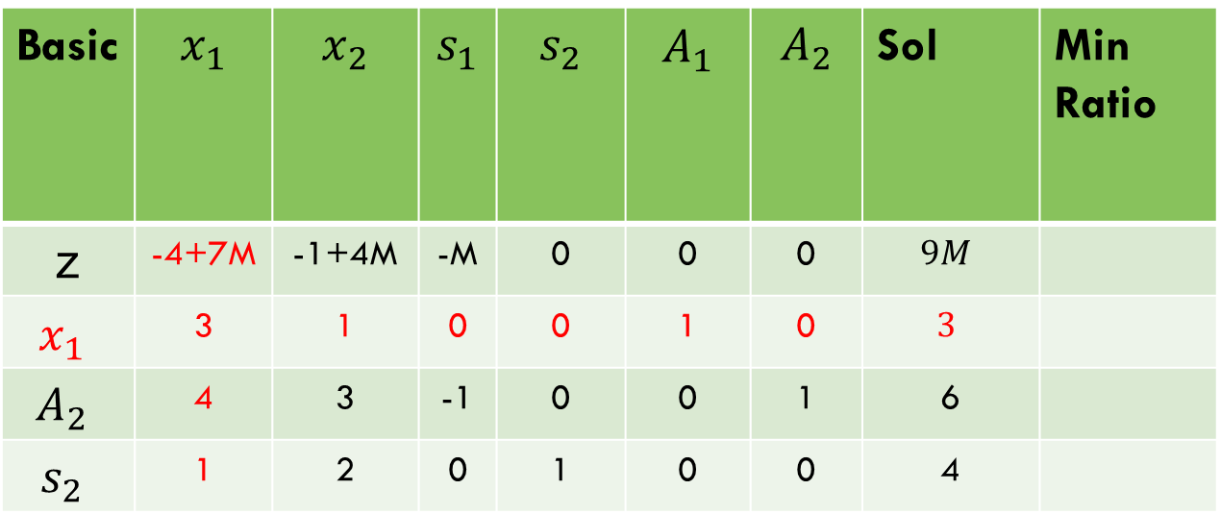
Big m method
Basic | $$x_{1}$$ | $$x_{2}$$ | $$s_{1}$$ | $$s_{2}$$ | $$A_{1}$$ | $$A_{2}$$ | Sol | Min Ratio
z | -4+7M | -1+4M | -M | 0 | 0 | 0 | $$9M$$
$$x_{1}$$ | 3 | 1 | 0 | 0 | 1 | 0 | $$3$$
$$A_{2}$$ | 4 | 3 | -1 | 0 | 0 | 1 | 6
$$s_{2}$$ | 1 | 2 | 0 | 1 | 0 | 0 | 4

Slide 24
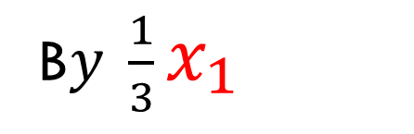
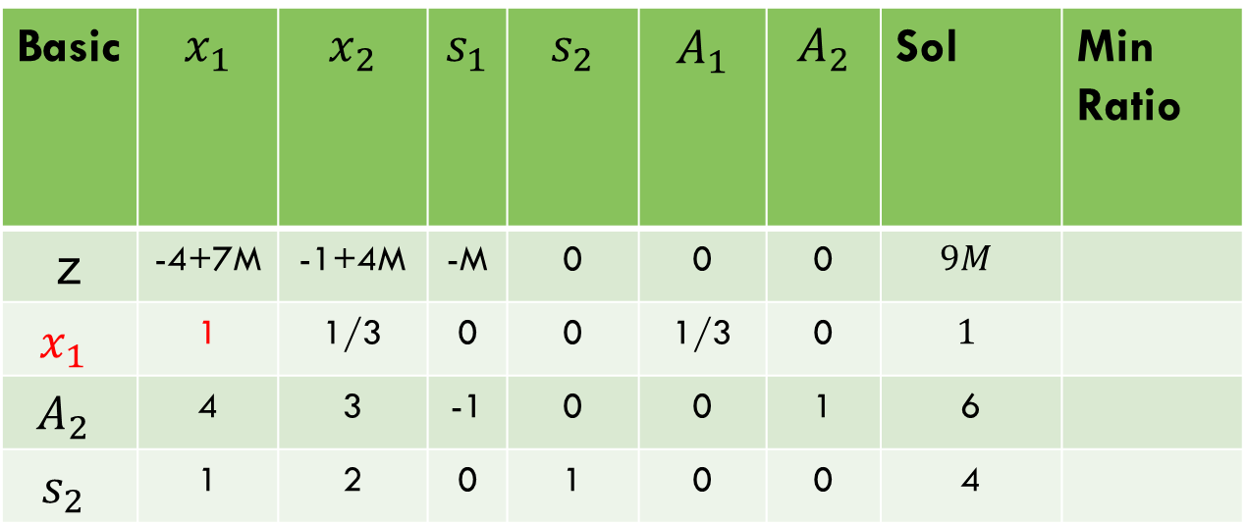
Big m method
Basic | $$x_{1}$$ | $$x_{2}$$ | $$s_{1}$$ | $$s_{2}$$ | $$A_{1}$$ | $$A_{2}$$ | Sol | Min Ratio
z | -4+7M | -1+4M | -M | 0 | 0 | 0 | $$9M$$
$$x_{1}$$ | 1 | 1/3 | 0 | 0 | 1/3 | 0 | $$1$$
$$A_{2}$$ | 4 | 3 | -1 | 0 | 0 | 1 | 6
$$s_{2}$$ | 1 | 2 | 0 | 1 | 0 | 0 | 4
B$y \frac{1}{3}x_{1}$

Slide 25


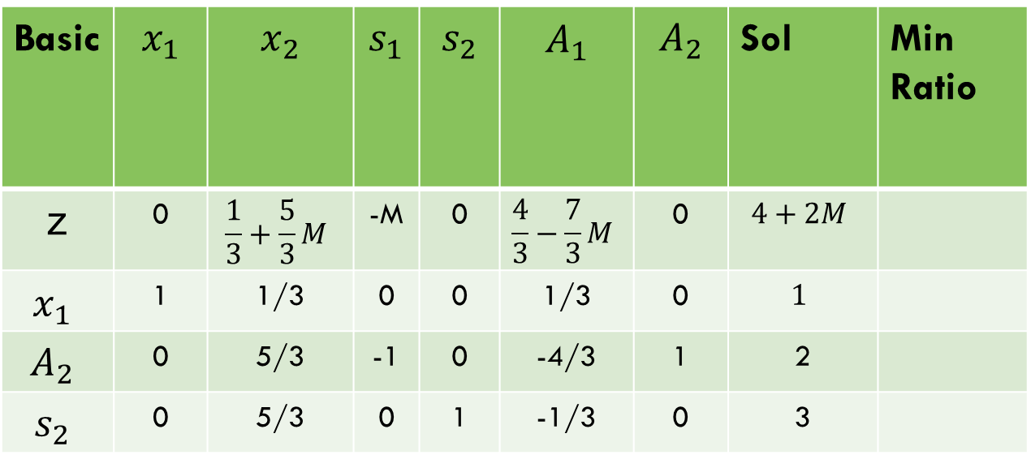

Big m method
Basic | $$x_{1}$$ | $$x_{2}$$ | $$s_{1}$$ | $$s_{2}$$ | $$A_{1}$$ | $$A_{2}$$ | Sol | Min Ratio
z | 0 | $$\frac{1}{3}+\frac{5}{3}M$$ | -M | 0 | $$\frac{4}{3}−\frac{7}{3}M$$ | 0 | $$4+2M$$
$$x_{1}$$ | 1 | 1/3 | 0 | 0 | 1/3 | 0 | $$1$$
$$A_{2}$$ | 0 | 5/3 | -1 | 0 | -4/3 | 1 | 2
$$s_{2}$$ | 0 | 5/3 | 0 | 1 | -1/3 | 0 | 3
$z−(−4+7M)x_{1}$,
$A2−4x_{1}$,
S2$−x_{1}$

Slide 26
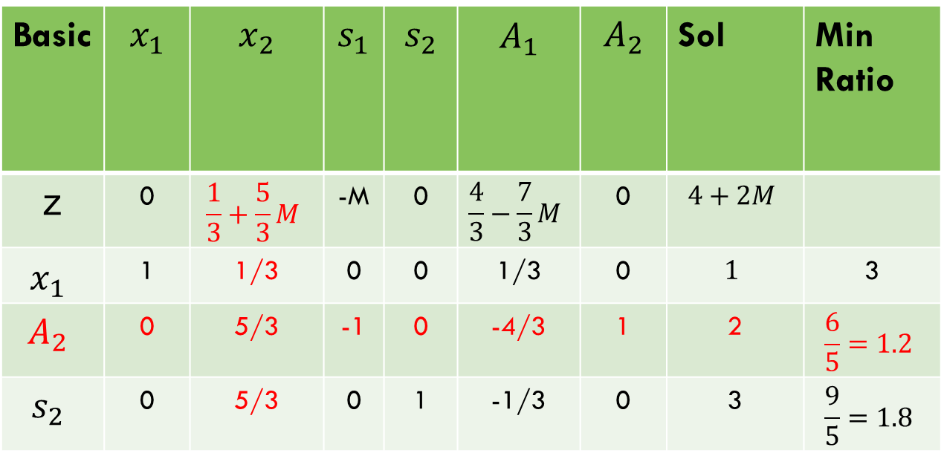
Big m method
Basic | $$x_{1}$$ | $$x_{2}$$ | $$s_{1}$$ | $$s_{2}$$ | $$A_{1}$$ | $$A_{2}$$ | Sol | Min Ratio
z | 0 | $$\frac{1}{3}+\frac{5}{3}M$$ | -M | 0 | $$\frac{4}{3}−\frac{7}{3}M$$ | 0 | $$4+2M$$
$$x_{1}$$ | 1 | 1/3 | 0 | 0 | 1/3 | 0 | $$1$$ | 3
$$A_{2}$$ | 0 | 5/3 | -1 | 0 | -4/3 | 1 | 2 | $$\frac{6}{5}=1.2$$
$$s_{2}$$ | 0 | 5/3 | 0 | 1 | -1/3 | 0 | 3 | $$\frac{9}{5}=1.8$$

Slide 27
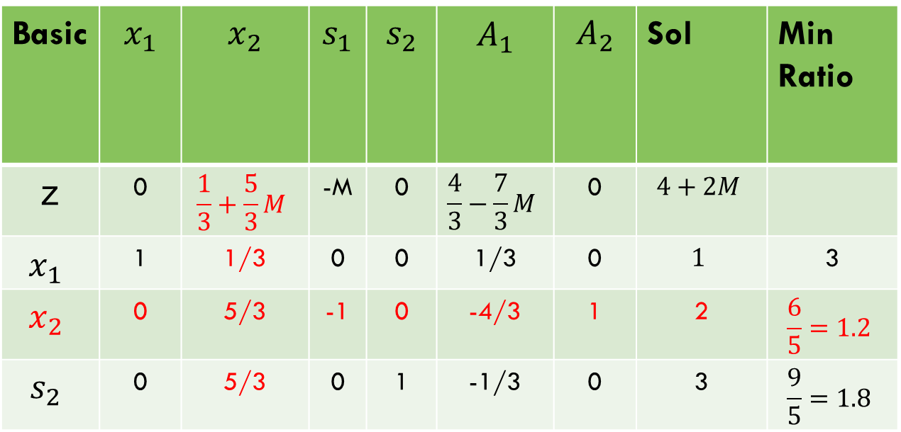
Big m method
Basic | $$x_{1}$$ | $$x_{2}$$ | $$s_{1}$$ | $$s_{2}$$ | $$A_{1}$$ | $$A_{2}$$ | Sol | Min Ratio
z | 0 | $$\frac{1}{3}+\frac{5}{3}M$$ | -M | 0 | $$\frac{4}{3}−\frac{7}{3}M$$ | 0 | $$4+2M$$
$$x_{1}$$ | 1 | 1/3 | 0 | 0 | 1/3 | 0 | $$1$$ | 3
$$x_{2}$$ | 0 | 5/3 | -1 | 0 | -4/3 | 1 | 2 | $$\frac{6}{5}=1.2$$
$$s_{2}$$ | 0 | 5/3 | 0 | 1 | -1/3 | 0 | 3 | $$\frac{9}{5}=1.8$$

Slide 28
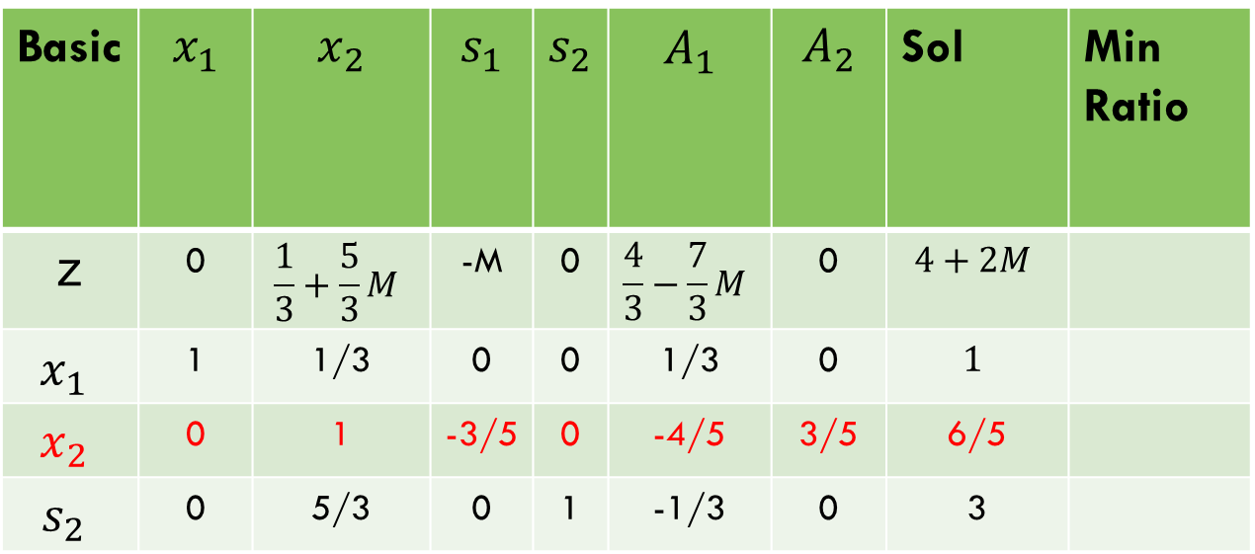

Big m method
Basic | $$x_{1}$$ | $$x_{2}$$ | $$s_{1}$$ | $$s_{2}$$ | $$A_{1}$$ | $$A_{2}$$ | Sol | Min Ratio
z | 0 | $$\frac{1}{3}+\frac{5}{3}M$$ | -M | 0 | $$\frac{4}{3}−\frac{7}{3}M$$ | 0 | $$4+2M$$
$$x_{1}$$ | 1 | 1/3 | 0 | 0 | 1/3 | 0 | $$1$$
$$x_{2}$$ | 0 | 1 | -3/5 | 0 | -4/5 | 3/5 | 6/5
$$s_{2}$$ | 0 | 5/3 | 0 | 1 | -1/3 | 0 | 3
B$y \frac{3}{5}x_{2}$

Slide 29
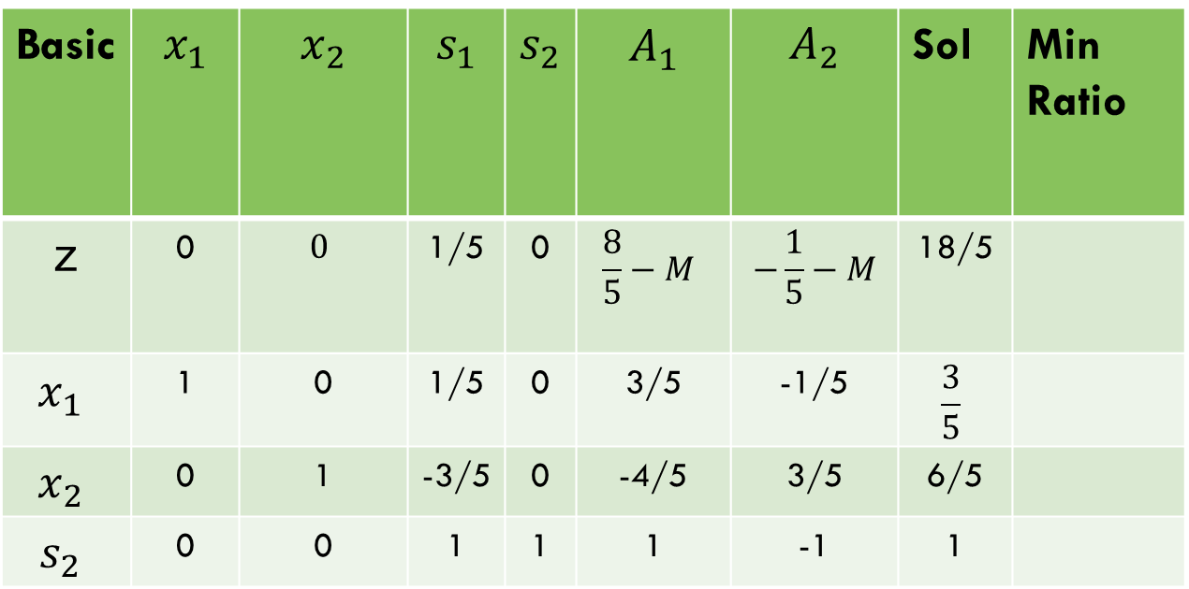
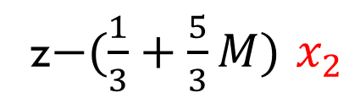


Big m method
Basic | $$x_{1}$$ | $$x_{2}$$ | $$s_{1}$$ | $$s_{2}$$ | $$A_{1}$$ | $$A_{2}$$ | Sol | Min Ratio
z | 0 | $$0$$ | 1/5 | 0 | $$\frac{8}{5}−M$$ | $$−\frac{1}{5}−M$$ | 18/5
$$x_{1}$$ | 1 | 0 | 1/5 | 0 | 3/5 | -1/5 | $$\frac{3}{5}$$
$$x_{2}$$ | 0 | 1 | -3/5 | 0 | -4/5 | 3/5 | 6/5
$$s_{2}$$ | 0 | 0 | 1 | 1 | 1 | -1 | 1
$s_{2}−\frac{5}{3}$ $x_{2}$
$x_{1}−\frac{1}{3}$ $x_{2}$
z$−(\frac{1}{3}+\frac{5}{3}M)$ $x_{2}$

Slide 30
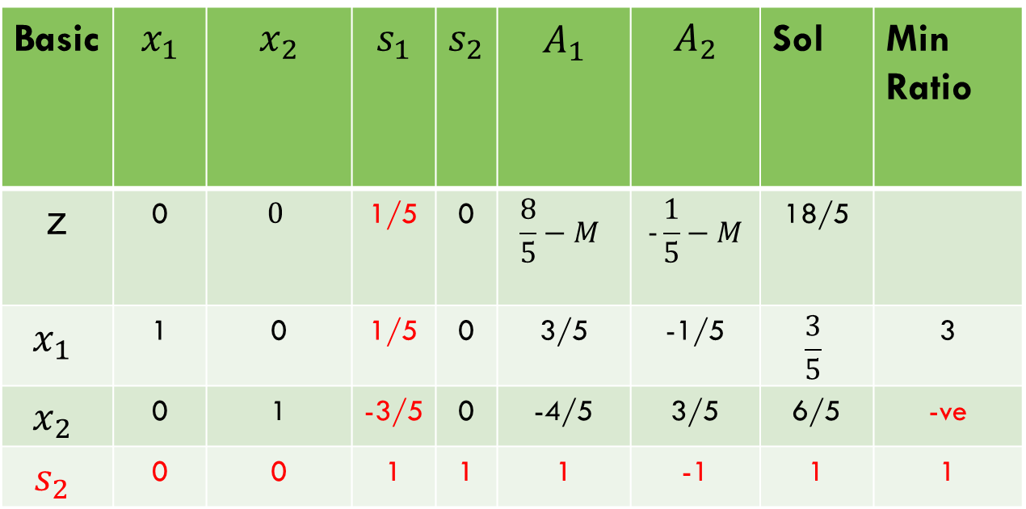
Big m method
Basic | $$x_{1}$$ | $$x_{2}$$ | $$s_{1}$$ | $$s_{2}$$ | $$A_{1}$$ | $$A_{2}$$ | Sol | Min Ratio
z | 0 | $$0$$ | 1/5 | 0 | $$\frac{8}{5}−M$$ | $$−\frac{1}{5}−M$$ | 18/5
$$x_{1}$$ | 1 | 0 | 1/5 | 0 | 3/5 | -1/5 | $$\frac{3}{5}$$ | 3
$$x_{2}$$ | 0 | 1 | -3/5 | 0 | -4/5 | 3/5 | 6/5 | -ve
$$s_{2}$$ | 0 | 0 | 1 | 1 | 1 | -1 | 1 | 1

Slide 31
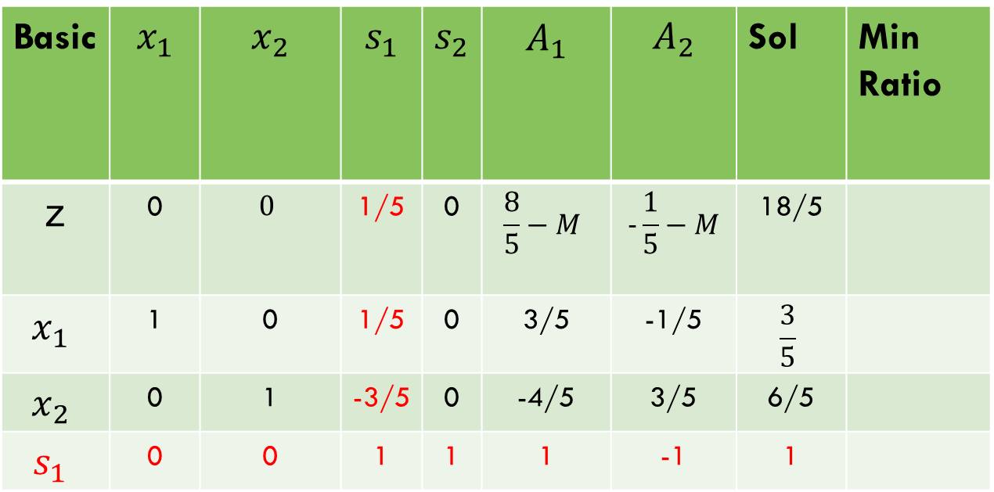
Big m method
Basic | $$x_{1}$$ | $$x_{2}$$ | $$s_{1}$$ | $$s_{2}$$ | $$A_{1}$$ | $$A_{2}$$ | Sol | Min Ratio
z | 0 | $$0$$ | 1/5 | 0 | $$\frac{8}{5}−M$$ | $$−\frac{1}{5}−M$$ | 18/5
$$x_{1}$$ | 1 | 0 | 1/5 | 0 | 3/5 | -1/5 | $$\frac{3}{5}$$
$$x_{2}$$ | 0 | 1 | -3/5 | 0 | -4/5 | 3/5 | 6/5
$$s_{1}$$ | 0 | 0 | 1 | 1 | 1 | -1 | 1

Slide 32
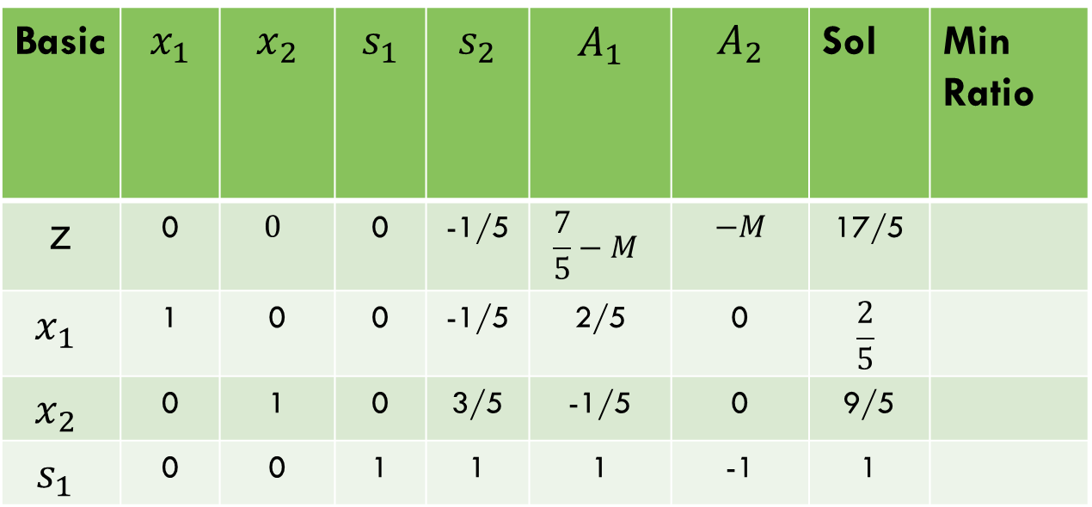



Big m method
Basic | $$x_{1}$$ | $$x_{2}$$ | $$s_{1}$$ | $$s_{2}$$ | $$A_{1}$$ | $$A_{2}$$ | Sol | Min Ratio
z | 0 | $$0$$ | 0 | -1/5 | $$\frac{7}{5}−M$$ | $$−M$$ | 17/5
$$x_{1}$$ | 1 | 0 | 0 | -1/5 | 2/5 | 0 | $$\frac{2}{5}$$
$$x_{2}$$ | 0 | 1 | 0 | 3/5 | -1/5 | 0 | 9/5
$$s_{1}$$ | 0 | 0 | 1 | 1 | 1 | -1 | 1
$x_{2}+\frac{3}{5}$ $s_{1},$
$x_{1}−\frac{1}{5}$ $s_{1},$
$z−\frac{1}{5}$ $s_{1}$

Slide 33
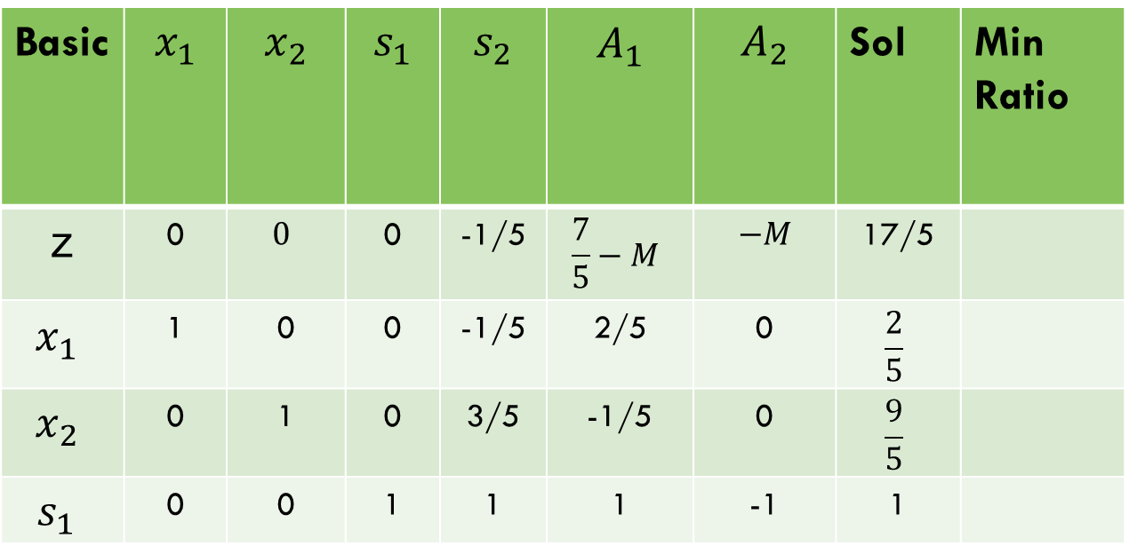
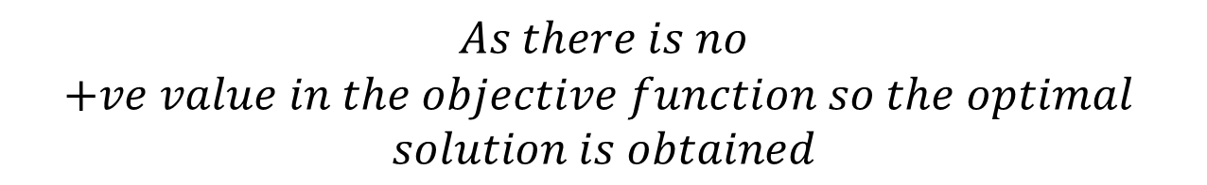
Big m method
Basic | $$x_{1}$$ | $$x_{2}$$ | $$s_{1}$$ | $$s_{2}$$ | $$A_{1}$$ | $$A_{2}$$ | Sol | Min Ratio
z | 0 | $$0$$ | 0 | -1/5 | $$\frac{7}{5}−M$$ | $$−M$$ | 17/5
$$x_{1}$$ | 1 | 0 | 0 | -1/5 | 2/5 | 0 | $$\frac{2}{5}$$
$$x_{2}$$ | 0 | 1 | 0 | 3/5 | -1/5 | 0 | $$\frac{9}{5}$$
$$s_{1}$$ | 0 | 0 | 1 | 1 | 1 | -1 | 1
$$As there is no$$
$$+ve value in the objective function so the optimal$$
$$solution is obtained$$

Slide 34

task
$$Max Z=3x_{1}+2x_{2}$$
Subject to Constraints:
$${2x}_{1}+x_{2}≤4$$
$$x_{1}+{2x}_{2}≥9$$

Slide 35
Thank you!

